Slide 1
Raw dentifera assembly
Filtered dentifera assembly
Contigs must be: linear, GC > 0.35 & < 0.41, Coverage > 1/3 of average, not Pseudomonadota

Slide 2
Raw longispina assembly
Filtered longispina assembly
Contigs must be: linear, GC > 0.35 & < 0.41, Coverage > 1/3 of average, not Pseudomonadota

Slide 3
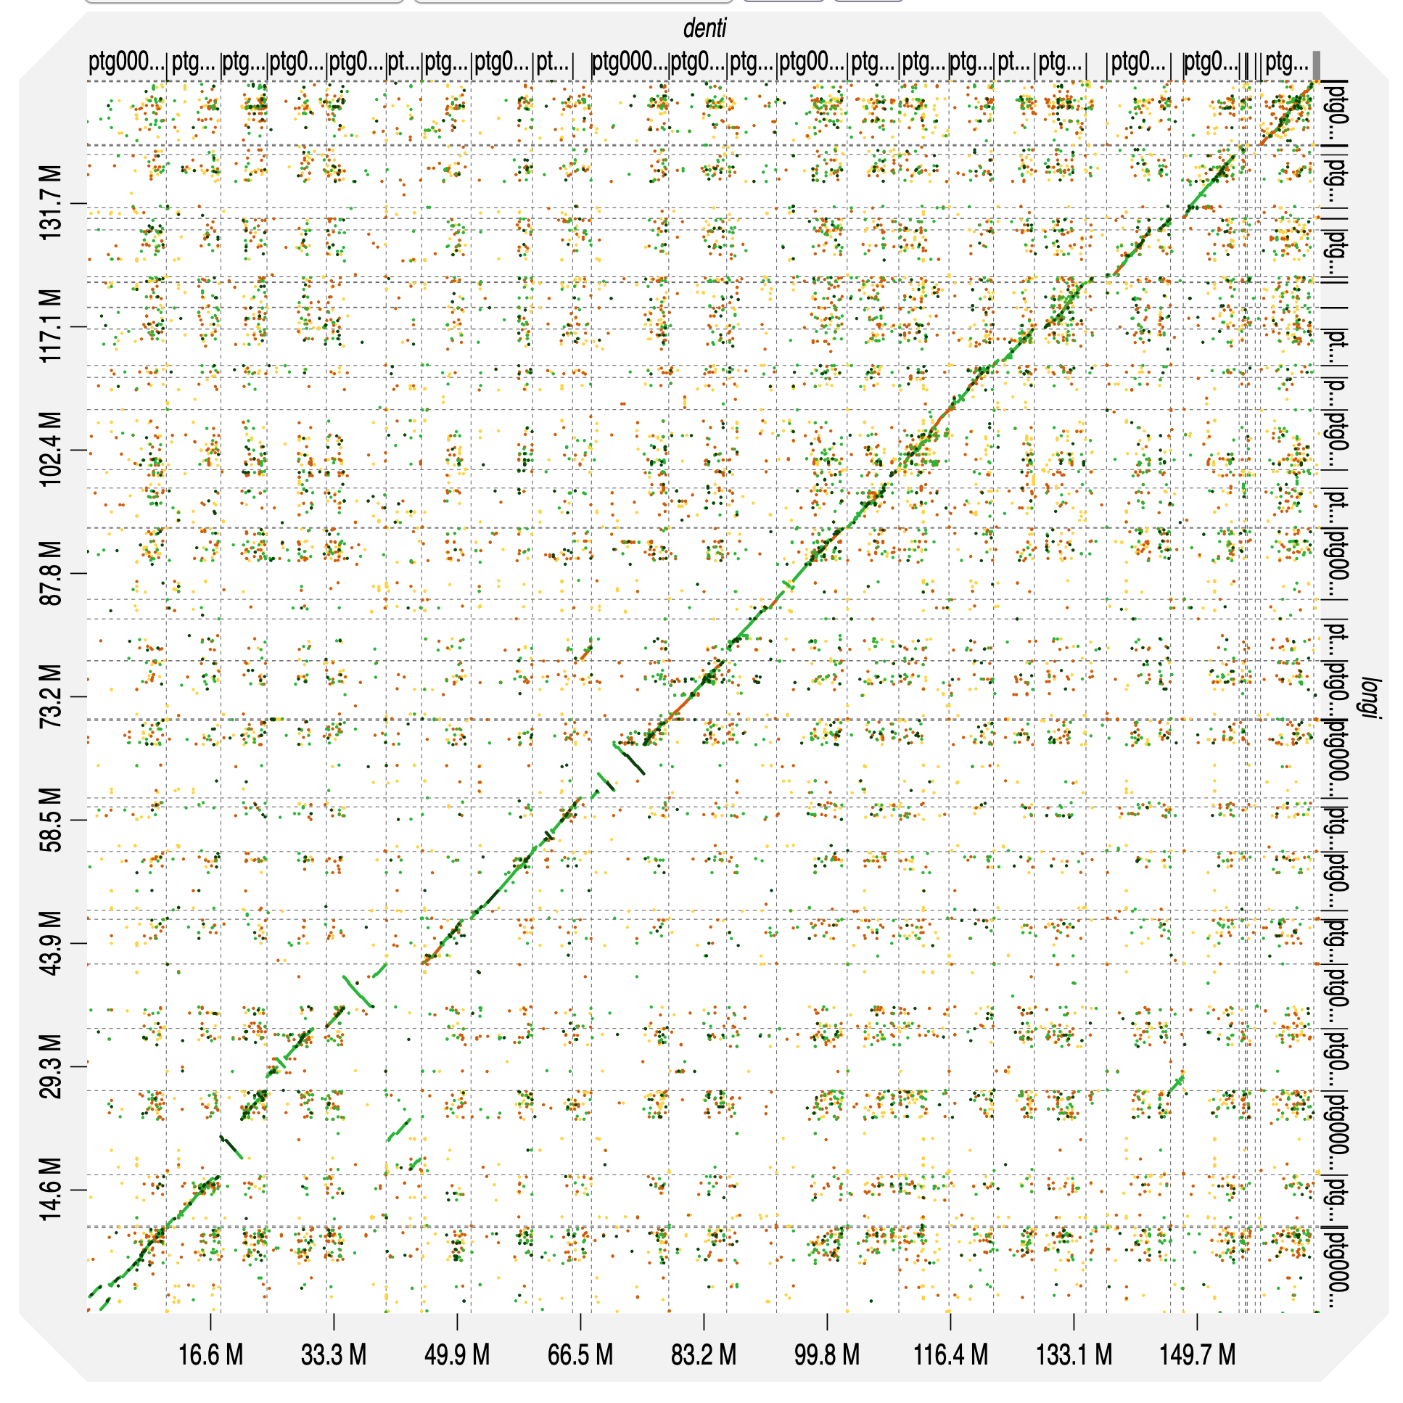
Between assembly comparison
D. dentifera
D. longispina

Slide 4
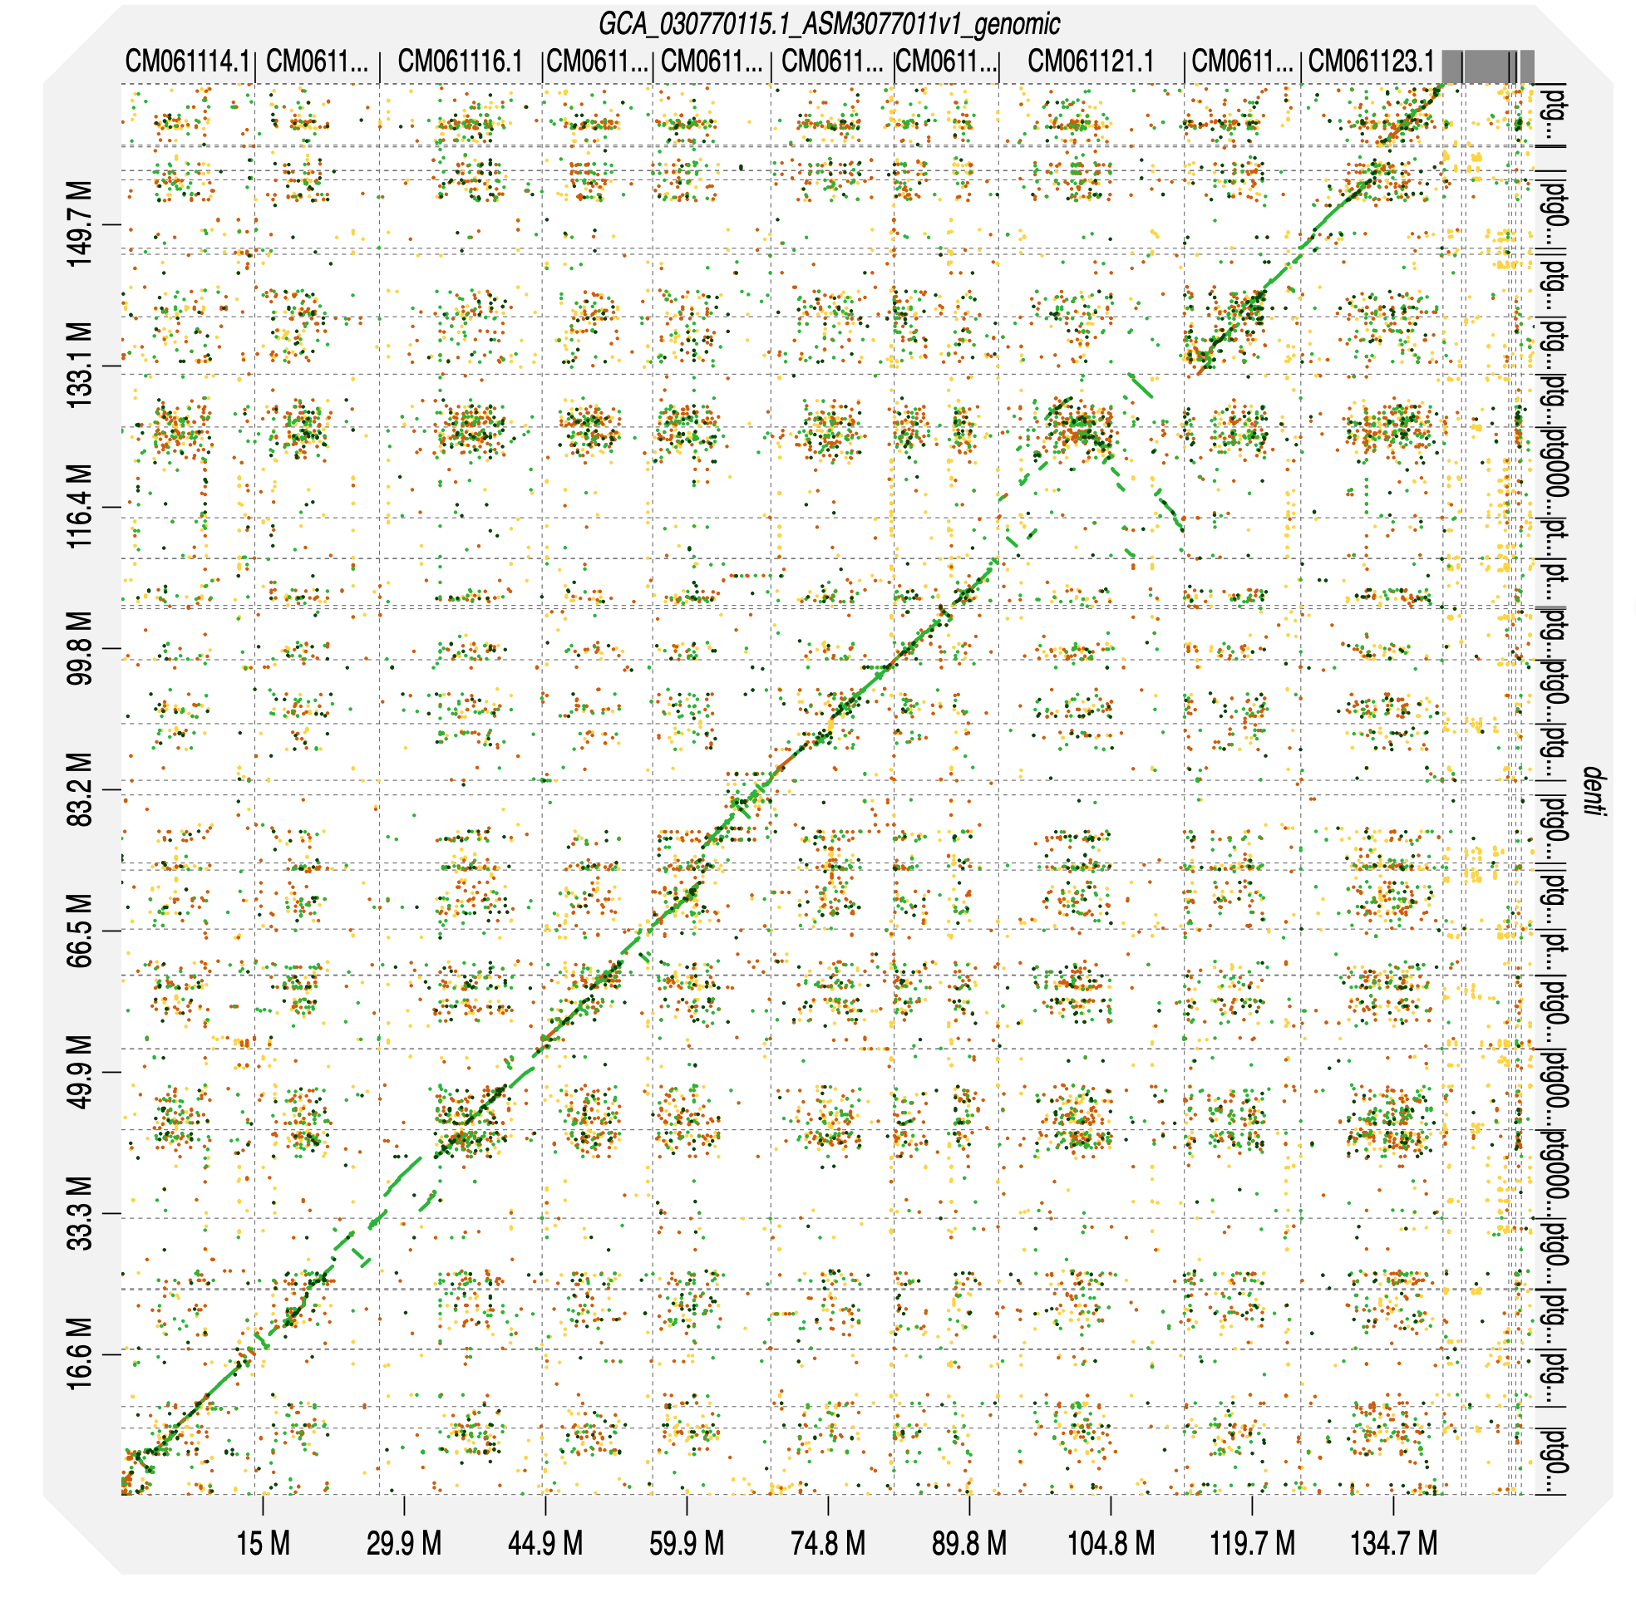
Between assembly comparison
D. galeata
D. dentifera

